Slide 1
Palm Beach Community Readmissions
Q3 2017–Q2 2018
Alina Prouty
Quality Improvement Specialist
Health Services Advisory Group (HSAG)
October 2018

Slide 2
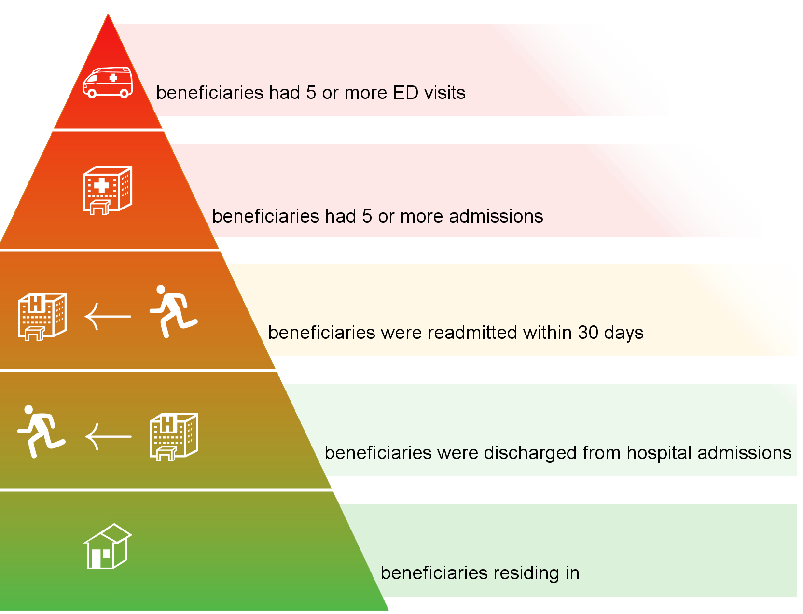
Community Population and Readmissions
216
909
6,277
34,885
185,515
Palm Beach Community
The Complete Standard Analytical Tables (CSAT) data file [Part A claims for Fee-For-Service (FFS) beneficiaries] was
used for this analysis for the time period 07/01/17–06/30/18.

Slide 3


















30-Day Readmissions by Volume
Q3 2017–Q2 2018
1
2
3
4
5
6
7
1,809 in days 1–3
1,890 in days 4–7
38%
Week one
685
414
12
212
722
554
464
4
146
486
Other*:
Other*:
8
9
10
11
12
13
14
2,420 in days 8–14
25%
Week two
Other:
915
762
575
12
156
15
16
17
18
19
20
21
19%
1,901 in days 15–21
Week three
668
589
Other:
466
6
172
22
23
24
25
26
27
28
Week four
1,841 in days 22–30
19%
611
412
Other*:
669
7
142
29
30
*Other: long-term acute care (LTAC), rehab facilities, psych facilities, critical access hospitals (CAHs), and left against medical advice (AMA).
= Home = Skilled Nursing Facility (SNF) = Home Health Agency(HHA) = Hospice
The CSAT data file (Part A claims for FFS beneficiaries) was used for this analysis for the time period 07/01/17–06/30/18.

Slide 4
Source of Readmissions Within Seven Days of Hospital Discharge
3,699 occurred within seven days of
hospital discharge.
38 percent had been discharged to home without home health agency (HHA).
The CSAT data file (Part A claims for FFS beneficiaries) was used for this analysis for the time period 07/01/17–06/30/18.

Slide 5

Seven-Day Readmissions and High-Risk Medications (HRMs)
Of the 2,834 patients readmitted within seven days of hospital discharge, 1,275 patients were on HRMs.
That is approximately two out of every five people.
The CSAT data file (Part A claims for FFS beneficiaries) and the Medicare Part D date file were used for this analysis for the time period 07/01/17–06/30/18.

Slide 6
Seven-Day Readmissions and HRMs
Patients on HRMs:
Drug Category | # of Readmissions | % of Readmissions
Opioids only
Anticoagulants only
Hypoglycemia only
Opioids + Anticoagulants
Opioids + Hypoglycemia
Anticoagulants + Hypoglycemia
Opioids + Anticoagulants + Hypoglycemia
232
18%
408
32%
257
20%
118
9%
83
7%
129
10%
48
4%
The CSAT data file (Part A claims for FFS beneficiaries) and the Medicare Part D date file were used for this analysis for the time period 07/01/17–06/30/18.

Slide 7

Medication-Related Readmissions
Most post-discharge adverse drug events(ADEs) are related to medications.
The odds of being hospitalized for ADEs are four to seven times higher in older adults.
Medication management is an evidence-based, proven strategy to improve medication safety.
1
.
7x
2
MTM
1. Greenwald JL, Denham CR, Jack BW. The hospital discharge: a review of a high risk care transition with highlights of a reengineered discharge process. J Patient Saf. 2007;3:97-106.
2. Salvi F, Marchetti A, D’Angelo F, et al. Adverse drug events as a cause of hospitalization in older adults. Drug Saf. 2012;
35 (Suppl 1):29-45.
Notes:
1. Greenwald JL, Denham CR, Jack BW. The hospital discharge: a review of a high risk care transition with highlights of a reengineered discharge process. J Patient Saf. 2007;3:97-106.
2. Salvi F, Marchetti A, D’Angelo F, et al. Adverse drug events as a cause of hospitalization in older adults. Drug Saf. 2012; 35(Suppl 1):29-45.
3. Ramalho de Oliveira D, Brummel AR, Miller DB. Medication therapy management: 10 years of experience in a large integrated health care system. J Manag Care Pharm. 2010;16(3):185-95.

Slide 8
Medication Interventions
Medication reconciliation:
– Comparison of all new and current medications
a patient is taking
Medication therapy management:
– Comprehensive review of all patient medications to ensure optimal outcomes
Chart review:
– Retrospective or real-time review
Medication screening project:
– Screening tools to identify discrepancies

Slide 9
Next Steps
HSAG invites providers to use the ADE Data Collection Tool to:
Screen patients who are taking HRMs.
Identify ADEs.
Determine interventions.

Slide 10
Thank you
Alina Prouty
Quality Improvement Specialist
AProuty@hsag.com
Office: 813.865.3185 │ Cell: 813.546.7748

Slide 11
This material was prepared by Health Services Advisory Group, Inc., the Quality Improvement Organization for Florida under contract with the Centers for Medicare & Medicaid Services (CMS), an agency of the U.S. Department of Health and Human Services. The contents presented do not necessarily reflect CMS policy. Publication No. FL-11SOW-C.3-11302018-11

